Slide 1
Zero Shot Learning for Zero Day Attacks
Grecil Parag Unadkat (22BAI1252)
Tanmay Deshpande (22BAI1224)
Satwik Arnav (22BAI1153)

Slide 2
CONTENTS
Introduction
Aim
Progress
Remaining Tasks

Slide 3
INTRODUCTION

Slide 4
What is ZSL?
ZSL or Zero-shot learning is a machine learning concept where models recognize unseen classes without explicit training. Unlike traditional models, ZSL leverages auxiliary information like semantic embeddings or attributes to generalize to new classes.

Slide 5
What is NIDS?
NIDS (Network Intrusion Detection System) is a security tool that monitors and analyzes network traffic for malicious activities or policy violations. It detects threats like unauthorized access, denial-of-service attacks, and malware infections using predefined rules or anomaly-based detection.

Slide 6
What is ZDA?
ZDA or a zero-day attack exploits a previously unknown software vulnerability, with cybercriminals gaining unauthorized access, stealing data, or causing damage. These attacks are dangerous due to the lack of warning and difficulty in detection.

Slide 7
AIM
Our aim is to create an MLP based NIDS that can not only detect usual threats but can also detect Zero-Day Attacks with excellent accuracy. We will then test this NIDS to detect Zero Day Attacks of various different attack types and observe the Zero-Day Detection Rates (ZDR) of various attack types. We will then try to find the Average Wasserstein Distance of distributions of features in the train vs. test sets of each zero-day attack to see why some attacks have lower ZDR than others

Slide 8
Methodology

Slide 9
Preprocessing
Data Collection
Data Cleaning
Labelling
Scaling
Train-Test-Split
We Converted the CIC IDS 2018 dataset to Pandas Dataframe.
We cleaned the data by removing unnecessary features, null and duplicate values.
We label encoded the attack type into the label column.
We Scaled the data using Min-Max Scaler, leaving the label untouched.
We split the data into in 70:30 ratio such that training data does not contain any zero-day attack data.

Slide 10
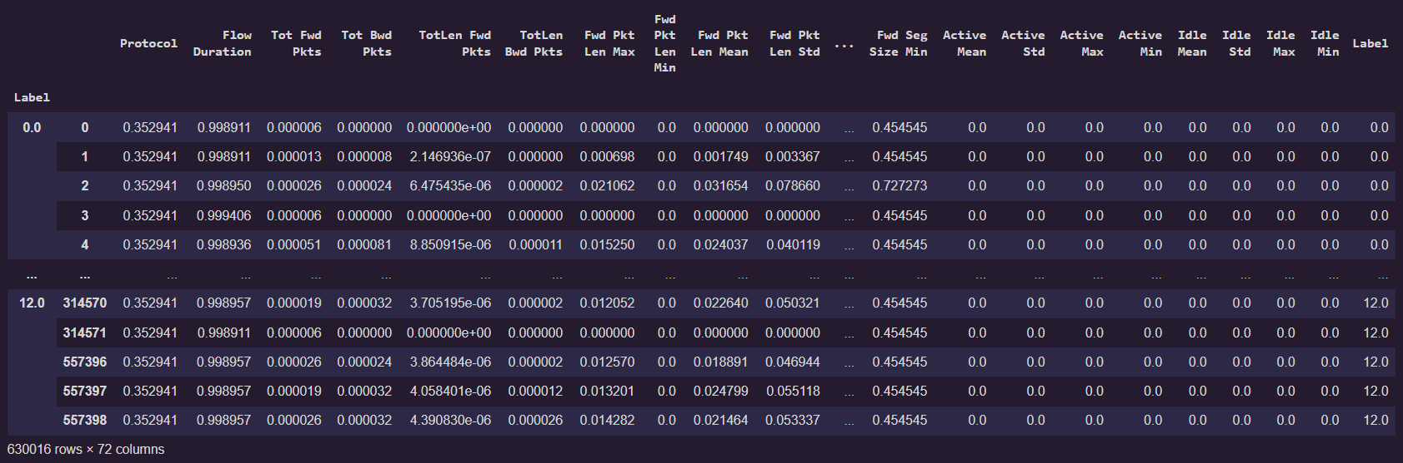
Preprocessing

Slide 11
Model Selection
We used a Sequential MLP from Tensorflow Keras.
The MLP has input layer of 71 units, 2 hidden layers of 100 units each and an output layer of 1 unit.
The hidden Layers use ReLU activation with L2 regularisation and output layer uses Sigmoid activation.
Model uses Adam Optimiser and loss function is Binary Cross Entropy. Model is trained for 50 epochs.

Slide 12
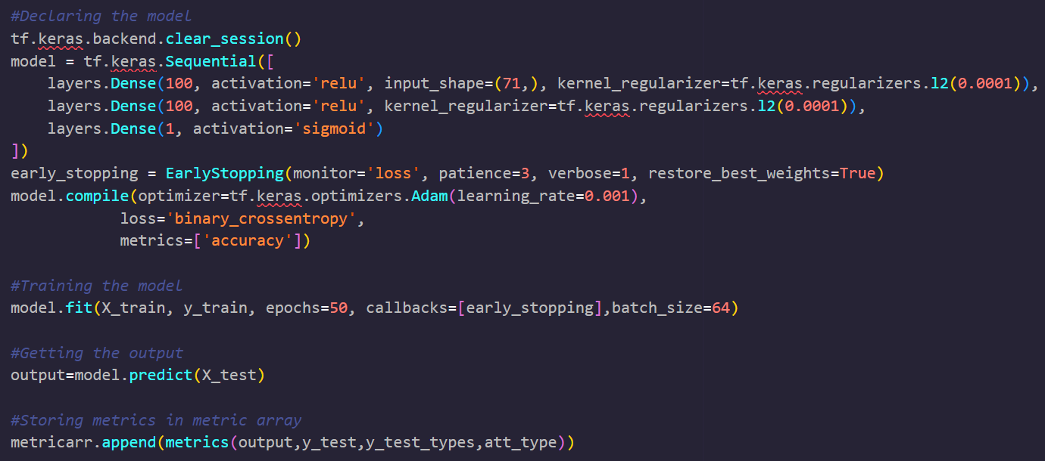
Model Selection

Slide 13
Performance Metrics
Accuracy - The percentage of correctly classified samples in the test set
Detection rate (DR) - The percentage of correctly classified total attack samples in the test set
False alarm rate (FAR) - The percentage of incorrectly classified benign samples in the test set
Zero-day detection rate (ZDR) - The percentage of correctly classified zero-day attack samples in the test set

Slide 14
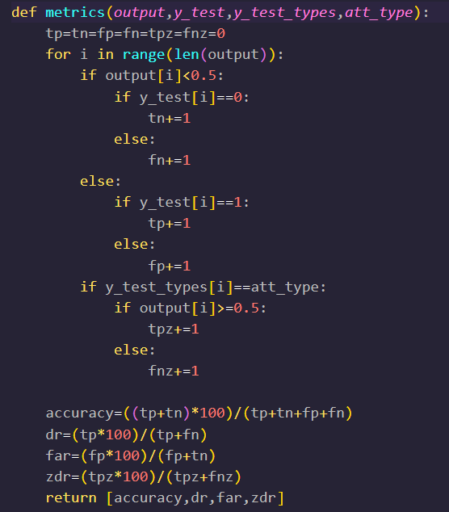
Performance Metrics

Slide 15
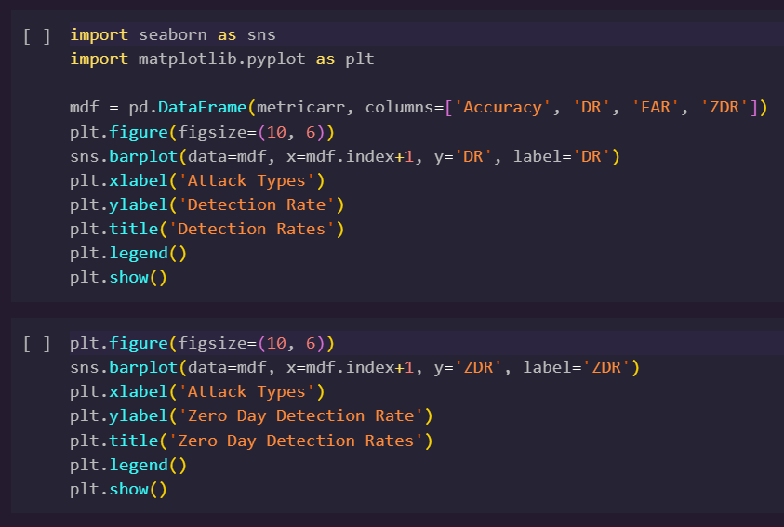
Plotting Metric Graphs

Slide 16
Wasserstein DIstance
We simulated zero-day attack scenario for each attack.
We calculated Wasserstein Distance of each feature of zero-day attack from the corresponding feature from known attacks.
We took the average of Wasserstein distances of all features from each zero-day attack.

Slide 17
Wasserstein DIstance
We simulated zero-day attack scenario for each attack.
We calculated Wasserstein Distance of each feature of zero-day attack from the corresponding feature from known attacks.
We took the average of Wasserstein distances of all features from each zero-day attack.

Slide 18
K-s Test statistic
K-S Test is a better statistic to measure goodness of fit because it is normalised, non-parametric and is not affected by the scale of data. It is very similar to t-test statistic.
We simulated the same zero-day attack scenario for getting K-S test statistic and plotted the outputs.

Slide 19
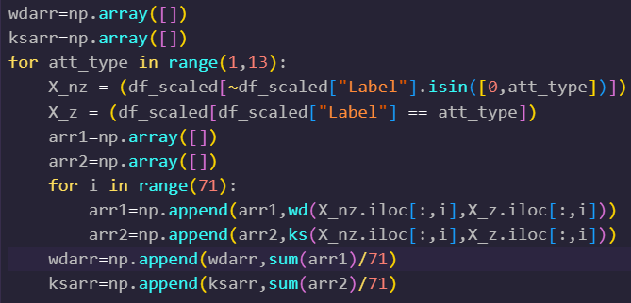
Goodness of fit Tests

Slide 20
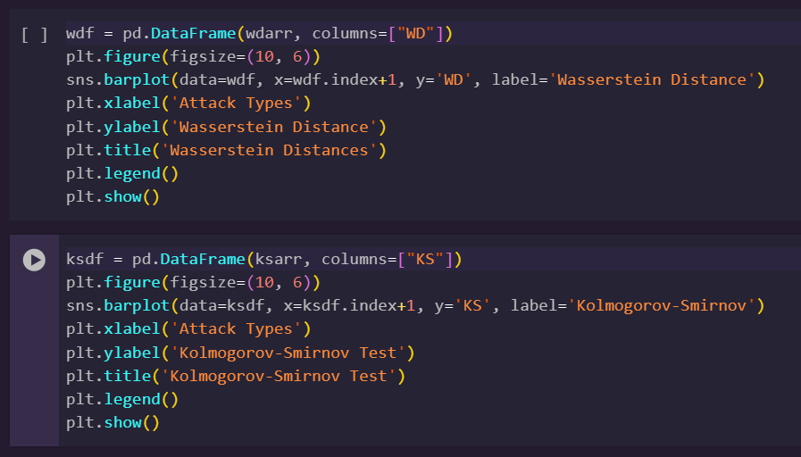
Plotting of Graphs

Slide 21
Results

Slide 22
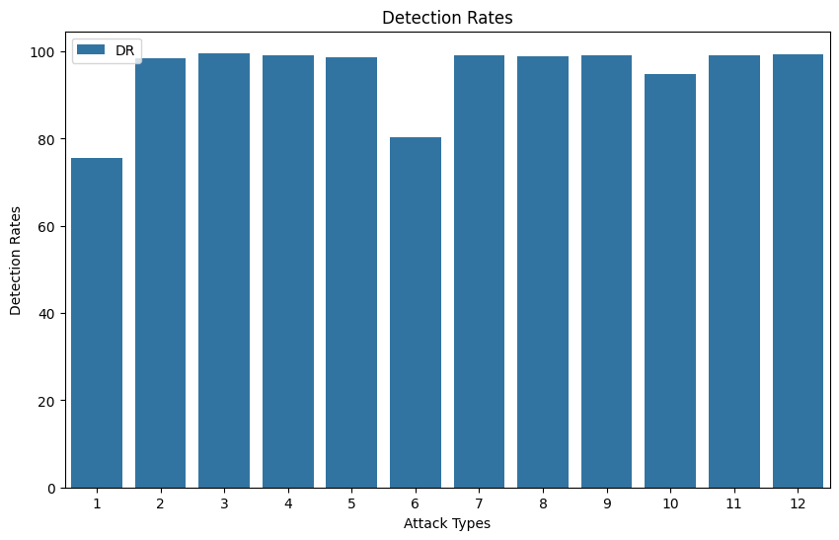
Detection Rates

Slide 23
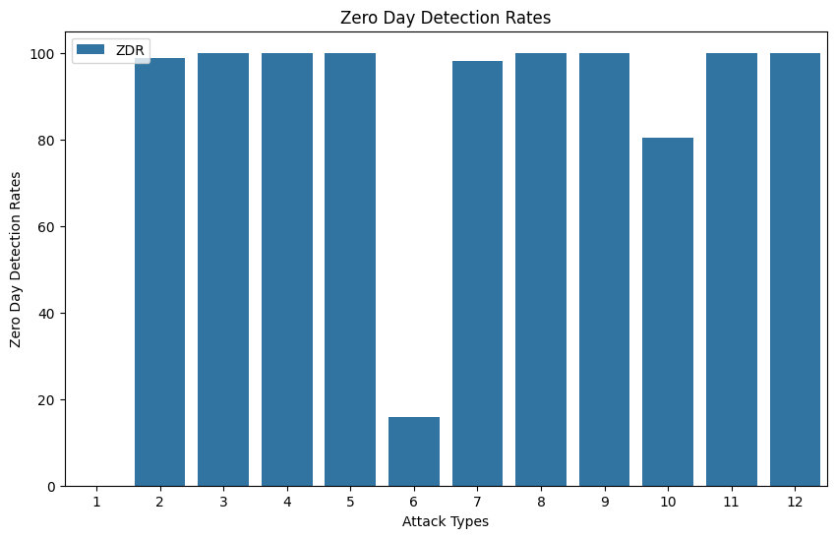
Zero-DAY Detection Rates

Slide 24
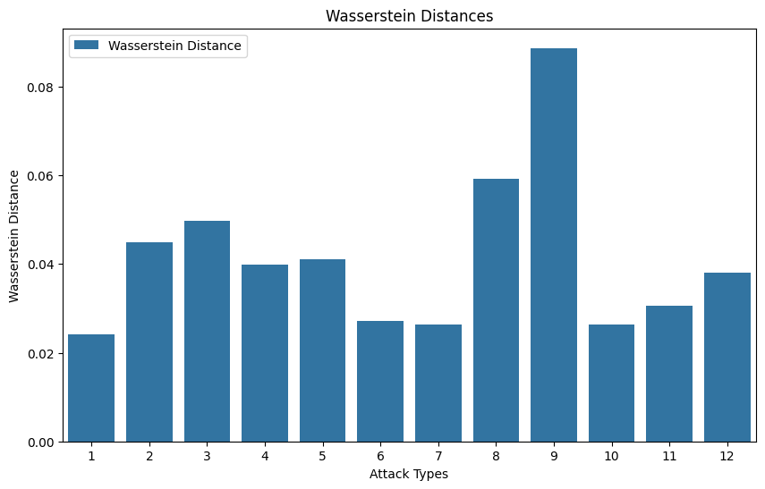
Wasserstein Distances

Slide 25
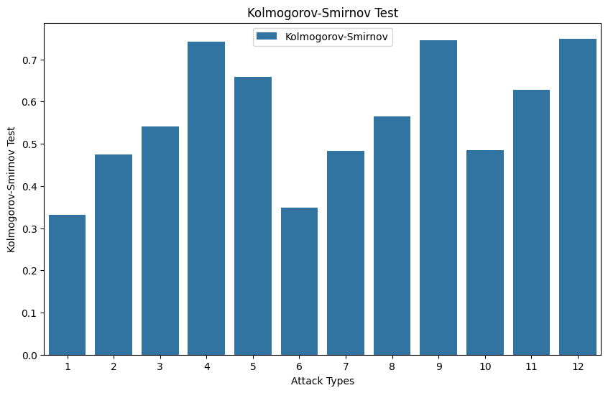
Kolmogorov-Smirnov Test

Slide 26
THANK YOU
Grecil Parag Unadkat (22BAI1252)
Tanmay Deshpande (22BAI1224)
Satwik Arnav (22BAI1153)

